Slide 1
What is DevOps?
Bryan Praditkul
August 2017

Slide 2
What are we covering today?
Introductions [in progress]
Life Before DevOps
What is DevOps
DevOps Principles & Practices
DevOps Journey To Date
Q&A

Slide 3
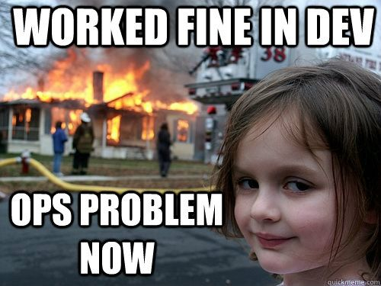
Life before DevOps…
Dev vs Ops organizations
Developers wrote code while Operations built/deployed
Infrequent releases
No Production access

Slide 4
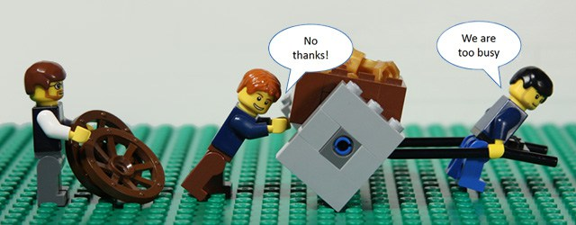
Change was inevitable
Teams/product were growing
Ops became the bottleneck
3 day boiling point
Finger pointing:
“It’s not our code, it’s your environment.” “It’s not the environment, it’s your code”
The problem became:
“How do we quickly scale our entire infrastructure to provide the best experience for our customers?”

Slide 5



What do people think DevOps is?
SysAdmin?
Automation and Monitoring?
Jr Recruiter
Jr DevOps Engineer
True DevOps

Slide 6
DevOps Defined
DevOps:
A cultural movement that stresses communication, collaboration, and integration between Dev and Ops while automating the process of software and infrastructure changes to bring value to end users.
Philosophy of Optimizing Value Delivery
True DevOps

Slide 7
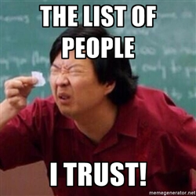
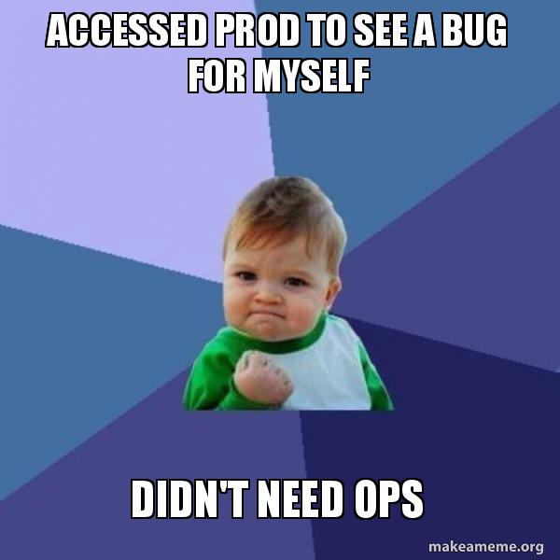
What is DevOps?
Partnership of trust between Dev and Ops
Enablement
Dependence

Slide 8
Executing on this vision = A newfound shared passion for…
Maintainability
CI/CD
Resilience
Security
Repeated
HADR
Monitoring
& Alerting
Scalability
Deployability

Slide 9
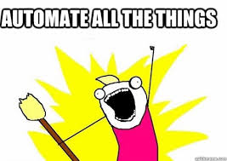
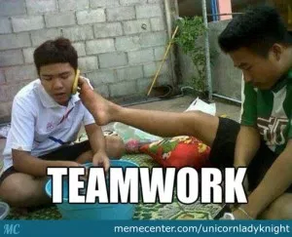

DevOps Principles
Holistic Vision
Collaborative and Communicative Culture
Self Service, Enablement
Automate (Infra/Config/Measure as Code)
In increments
Iterative, Ok to Fail
Continuous Process

Slide 10
DevOps Principles – Continue Process and Culture
Functional Quality
Code Quality
Continuous Deployment
Continuous Delivery
Monitor & Measure
Create Environment
Build Confidence
Continuous Integration
Requirements
Code
& Review
Build
Configure & Deploy
Test
Check & Promote to Prod
Effective Branching
Feedback
Fail Fast
Process Quality
Continuous feedback on technology, culture, documentation, and measurement

Slide 11
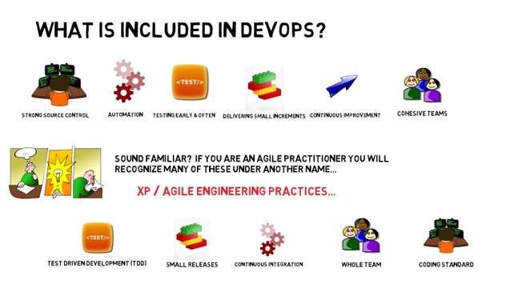
DevOps and Agile
Agile + Operationalization (Continuous Improvement) = DevOps

Slide 12
DevOps Practices
Usage Monitoring
Telemetry Collection
Testing in Production
Stakeholder Feedback
RCA outcomes
Peer Code Reviews
Automated Testing
Continuous Measurement
Agile Documentation
Shift-left into the Inner Loop
DevSecOps
Infrastructure as Code
Configuration as Code
Leverage Cloud services
Automatic Scaling
Proper environments
Containerization
Microservices Architecture
Chat bots
Automated Testing
Continuous Integration
Continuous Deployment
Automated Release Management
Chat bots
Flow of Customer Value
Autonomy and Alignment
Backlog improved by learning
Evidence gathered in production
Technical
Debt
Control
Live Environment
Mindset
Flexible
Infrastructure
Testing in Production
Usage Monitoring
User Telemetry
Stakeholder feedback
Feature flags
Experiments
Agile/Kanban
Journey Teams
Cross Team Collaboration
Communication
Application Performance Management
Infrastructure as Code
Continuous Delivery
Release Management
Configuration as Code
Self Healing

Slide 13
Levels of DevOps Maturity
Communication
Automation
Consistency
Mature
Effective knowledge sharing. Visible processes Auto generated analysis of output
Automation enables self service
Process risk and cost optimization
Intermediate
Collaborative processes with metrics of output
Data collection from automated processes, gap identification with business vision
Visible and predictable processes with defined quality output
Basic
Collaborative communication
Centralized and coherent automation across all JTs
Standardized processes, Proactive
Initial
Managed Communication, decision sharing
Siloed automation, lack of central infrastructure
Managed processes, reactive, non-standardized
No DevOps
Poor communication
No Automation
Reactive, Unpredictable, Uncontrolled processes
Source: https://www.slideshare.net/MuktaArankalleAphale/enabling-enterprises-to-adopt-devops

Slide 14
Sample DevOps Maturity Journey
Category | 2015/early 2016 | Today
Monitoring | Reactive | Proactive, config automated, L1/L2, logs
Incident Triage | Manual by Ops Only | Improved MTTR, chatbots, all hands on deck (any TZ)
Culture | Dev vs Ops Fences | Empowerment
Releases | Biweekly 6-30hrs | Blue/Green-safe releases < hr, release 9x/week
Availability | Manual tracking | 99.9% (heading to 4-9s, 52mins/yr, 8.6s/day)
QA Testing | Only by QA or Dev | All with a sense of ownership, Chatbots
Environment Provisioning | In months, higher costs by Ops while waiting | In mins, 37 new dev envs in 10days, 11 pushed to prod
Security | Security Audits | Auto-remediation in 2-5mins (throttled for convenience), auto shutdown, integrated at bootstrap

Slide 15
Why are we still maturing?
Culture
Collaborative culture still not developed
Inconsistent change review process
Test Automation
Test automation is still neglected or is still in progress.
Security is still an afterthought
Legacy
Legacy apps are still around, wasting resources as deployments are tougher
Managing Environments
Complex environments are not standardized or automated
Changes aren’t well communicated
No DevOps Plan
plans are unclear, no owners, deliverables aren't well defined
App Complexity
Application architecture changes don't account for infrastructure early on
Level of monitoring is insufficient
Skillset
Teams aren't trained. Processes aren't standardized, no across the board common operational procedures
Budget
Open Source is assumed to be free; integration and operational complexity not considered
Tools
Toolsets are fragmented incurring operational overhead
Mask true issues by leveraging alternative solutions
Executive Support
Leadership education creates a resource and budget misalignment
Source: Quali.com annual DevOps survey 2016

Slide 16
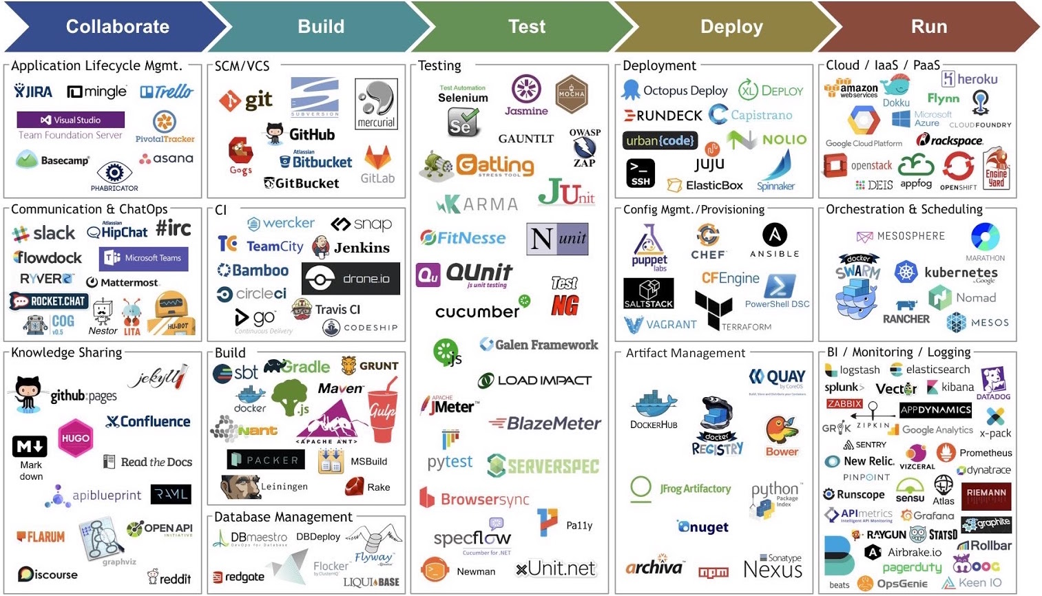
DevOps Tooling Challenges
Source: http://maximelanciauxbi.blogspot.com/

Slide 17
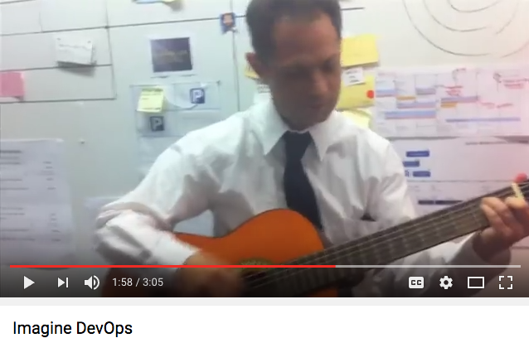
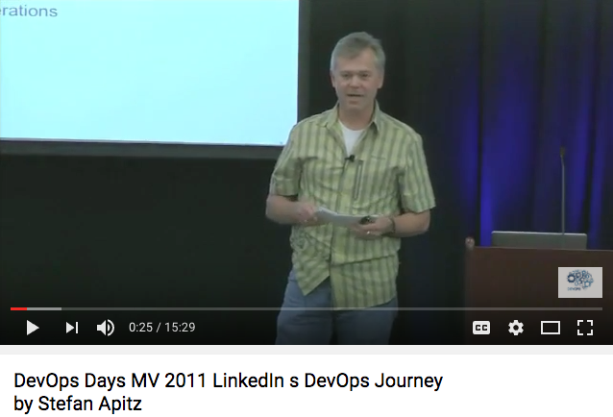
Fun Factoid: How did DevOps Evolve?
Flickr holds “10+ Deploys a Day” session
2009
2003 Scaling Pitch to AWS CEO
Explosion of meetups begins
2003
2010
DevOps Continues to evolve
Dubois embarks on learning mission
Today
2007
before 2006
2006
2007
2008
2009
2010
2011
…
2015
2017
March 2006
2015
AWS launched S3
Wide embrace of DevOps
Shafer holds ”Agile Infrastructure” session
2009
2008
Dubois and Shafer organize DevOpsDays in Belgium, Syndey, and Mountain View
2011
Tech Analysts prediction for 2015 wide-scale adoption

Slide 18
Emerging 2017 DevOps Trends
Lifecycle recognition of it’s own [already happening]
Testers will need to learn to code
Movement to cloud, but not as PaaS
Containers gain greenfield traction
Orchestration tool will begin to dominate
Microservices hype revisited
Serverless takes on the market (FaaS)
Big Data ❤️ DevOps
Convergence of Tools

Slide 19
If nothing else, remember…
“DevOps isn’t something you build; it’s something you do”
-Lori MacVittie
“DevOps is not a goal, but a never-ending process of continual improvement”
-Jez Humble
“Delivery teams run software products – not projects – that run from inception to retirement
-Jez Humble

Slide 20
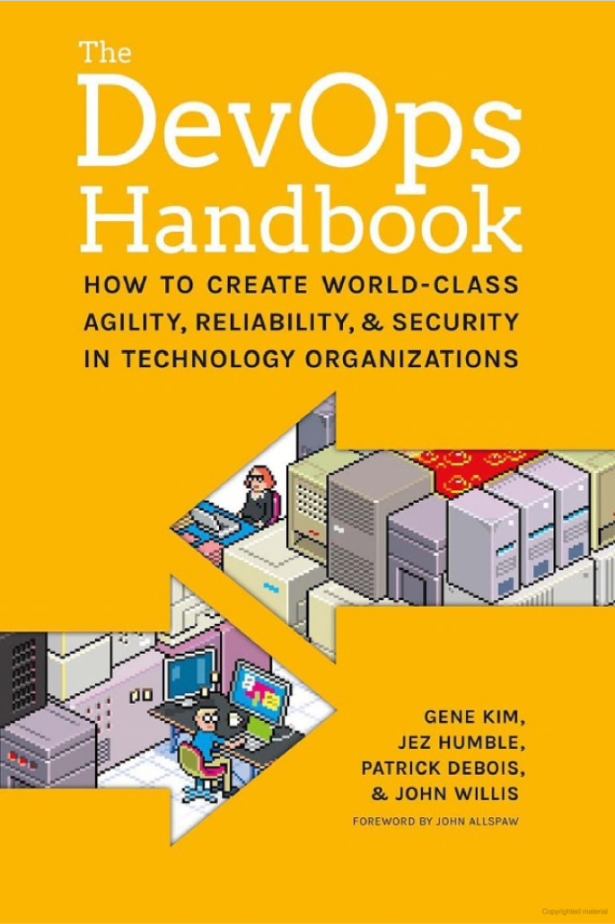
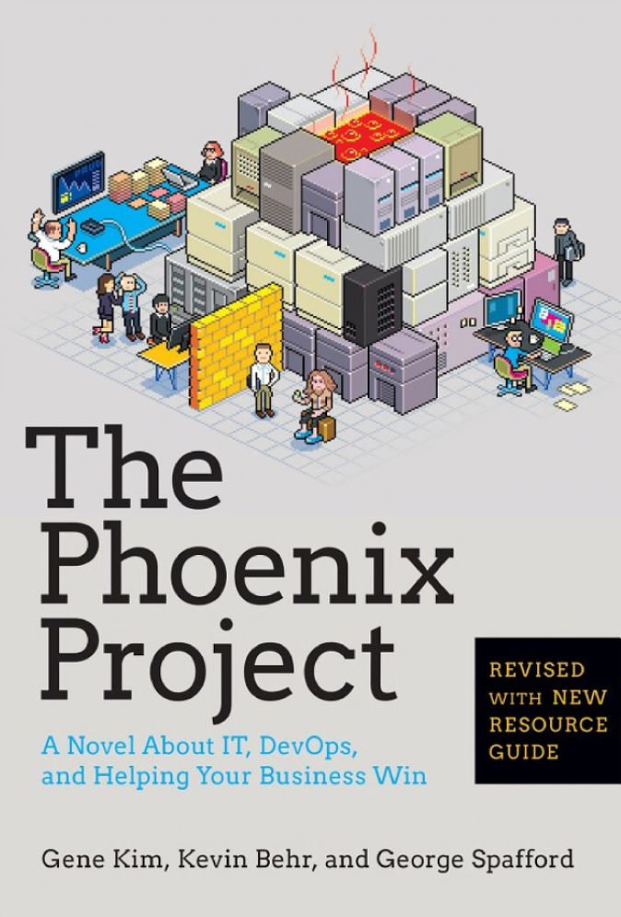
Useful Links and Books
Agile vs DevOps https://youtu.be/WqoVeGFjK9k
Inspirational Videos https://www.youtube.com/watch?v=_DEToXsgrPc
https://www.youtube.com/watch?v=877OCQA_xzE&t=85s
https://www.youtube.com/watch?v=Nw0_26xbmX8
https://www.youtube.com/watch?v=yIlNTnA-zUs
DevOps Song https://www.youtube.com/watch?v=iYLxw6OsZug
Conferences https://conferences.oreilly.com/velocity/vl-ny?cmp=kn-webops-confreg-home-vlny17_branded
2017 Trends https://techbeacon.com/7-devops-trends-watch-2017
https://enterprisersproject.com/article/2017/1/devops-trends-emerging-2017-and-beyond
Original Flickr Discussion https://www.slideshare.net/jallspaw/10-deploys-per-day-dev-and-ops-cooperation-at-flickr

Slide 21

Q & A

